Slide 1
Philippines
National Research Update
2010

Slide 2
How is our progress in saturating the entire Philippines with churches?

Slide 3
Good news:
Churches are multiplying!

Slide 4

Continuous Church Planting!
We’re planting 9 churches in the Philippines every day!
Notes:
4

Slide 5
Progress!
 | 1974 | 2000 | 2010
Churches | 5,000 | 51,300 | Over 77,000
Percent born again | 1.8% | 8.9% | Over 12%
Number of believers | 600,000 | 7.2 million | Over 11 million
Notes:
5

Slide 6
Reaction
Ano ang reaction mo sa impormasyong ito?
Share with the person next to you for 1 min.

Slide 7
Much remains to be done!

Slide 8
The Task Remaining
(Projected to 2010)
23,000 barangays still have no church
30 million people reside within these barangays

Slide 9
Unchurched barangays: Luzon (2010)

Slide 10
Unchurched barangays
Visayas, Mindanao (2000)

Slide 11
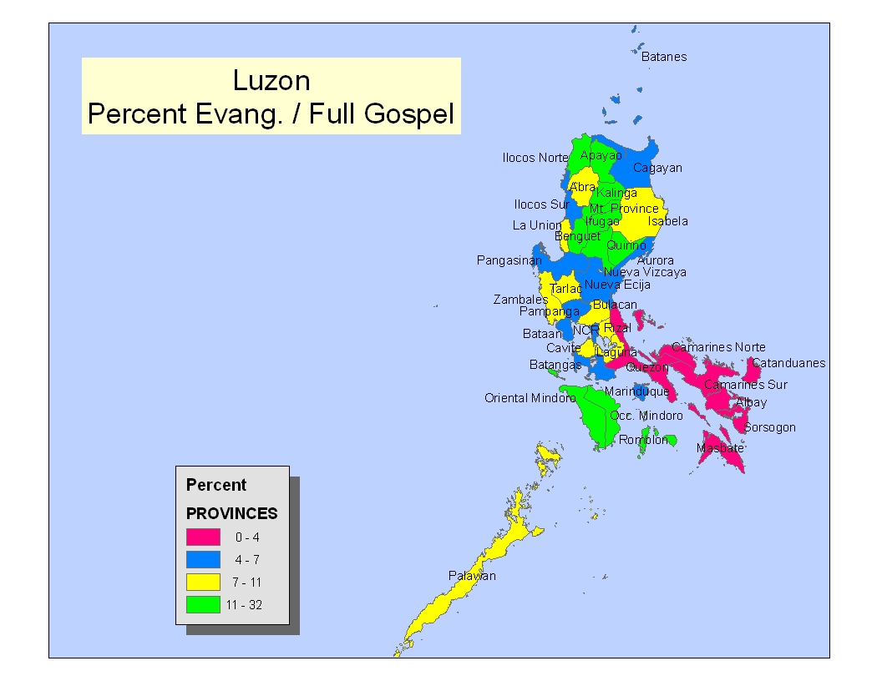

Slide 12
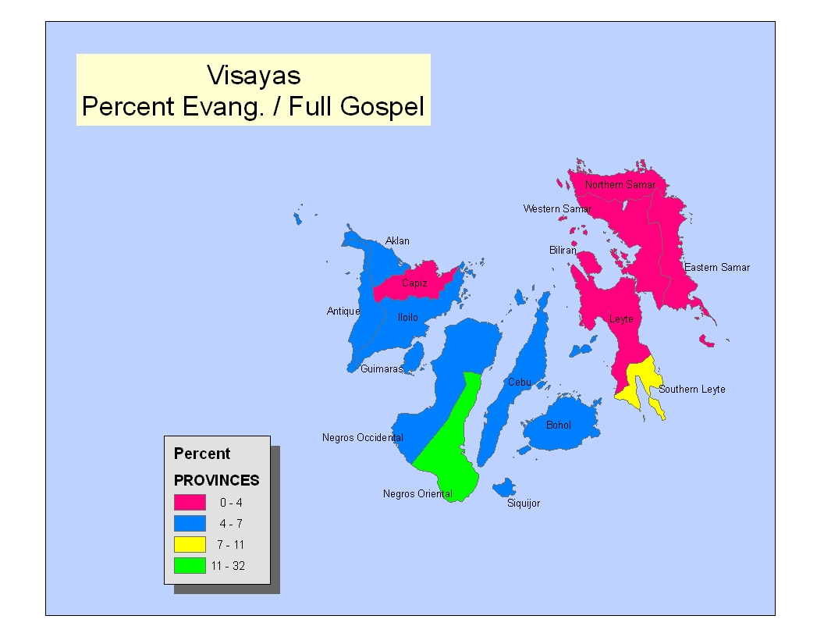

Slide 13
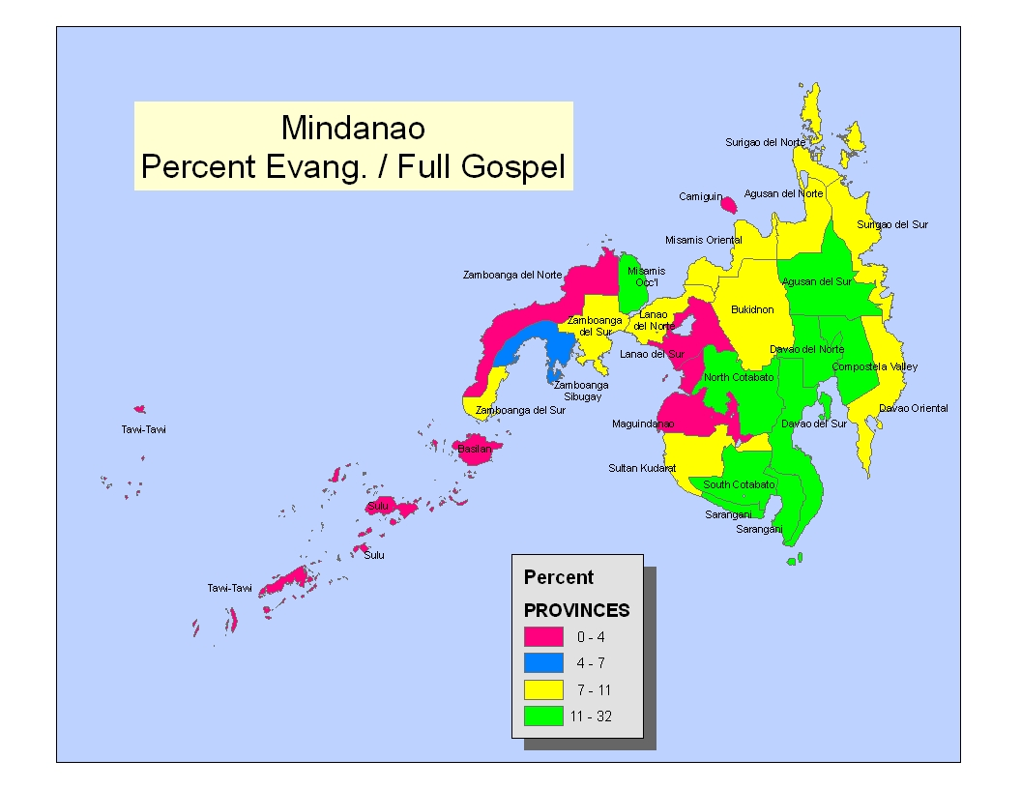

Slide 14
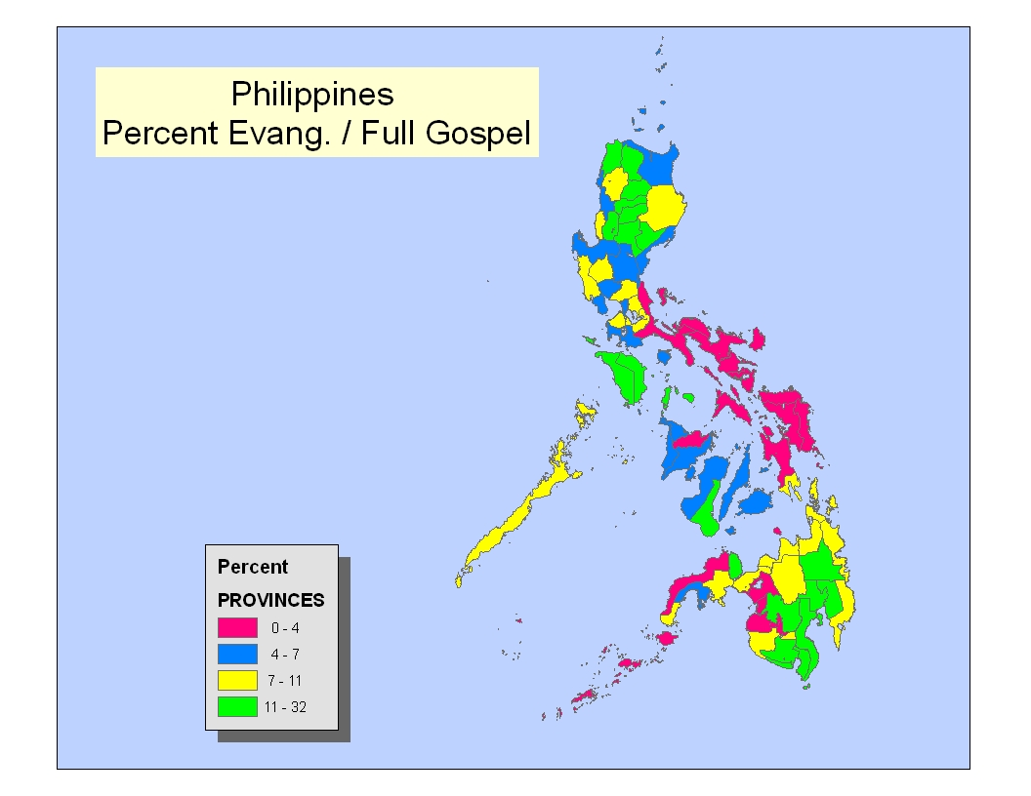

Slide 15
Growth rates have dropped severely
Notes:
-explain growth rate.
-halos sa lahat ng ina-update namin, malos bumaba
-noong 2000, on the national level-7.5

Slide 16
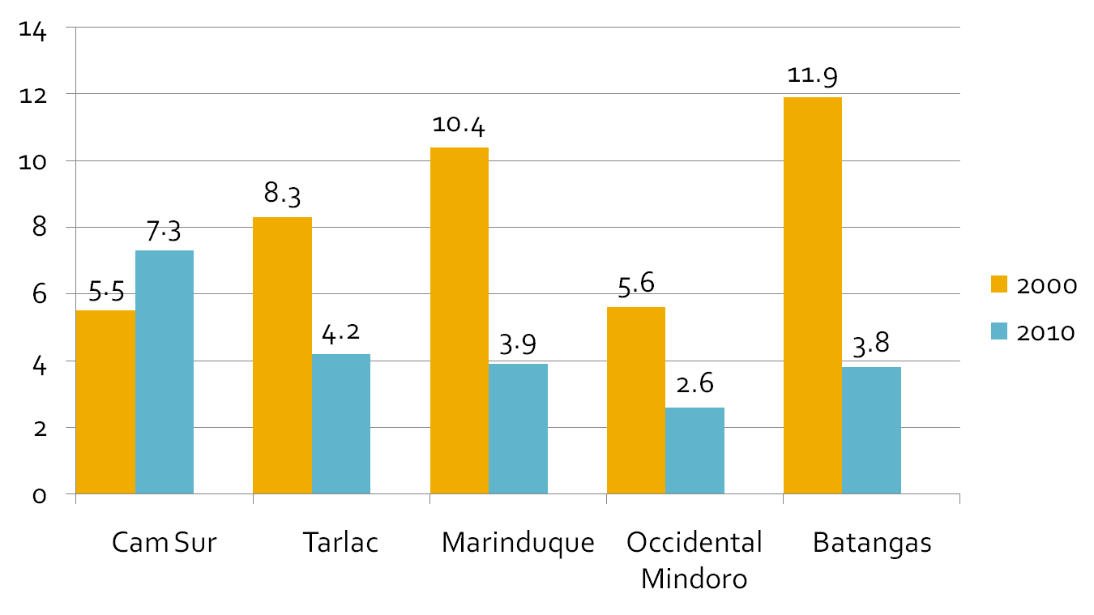
Bakit kaya bumaba ang mga growth rate?
Discuss for 5 min.

Slide 17

For more information …
For complete information on every province, town and barangay go to www.philchal.org. Click on “DAWN Research.”

