Slide 1
Cagayan
Provincial Research
Notes:
1

Slide 2
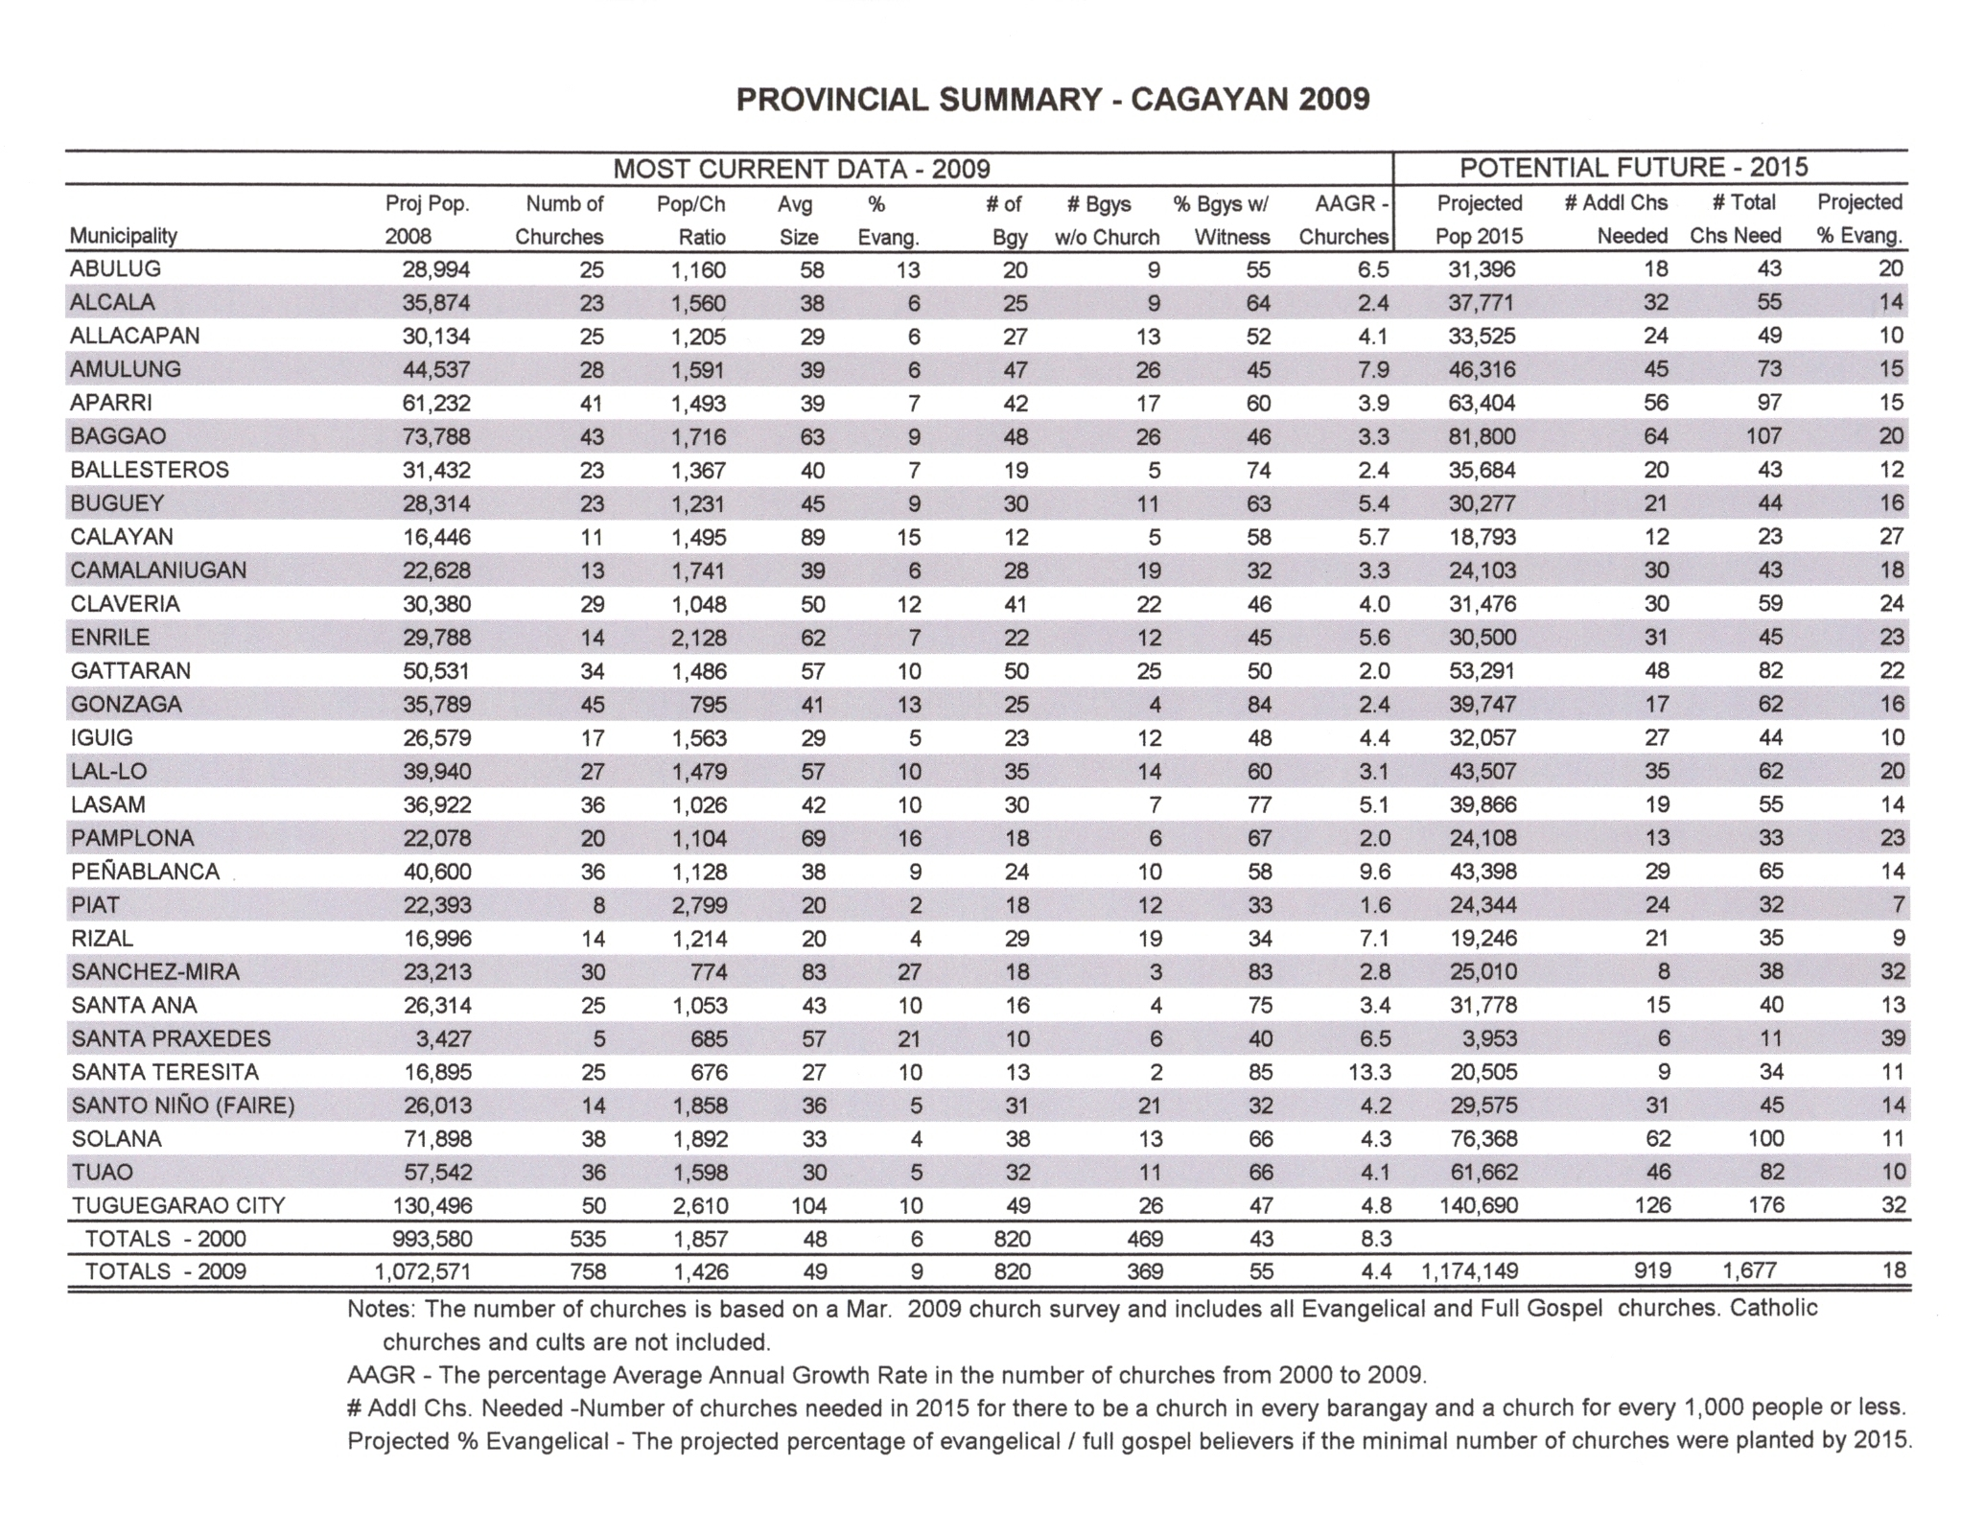

Slide 3
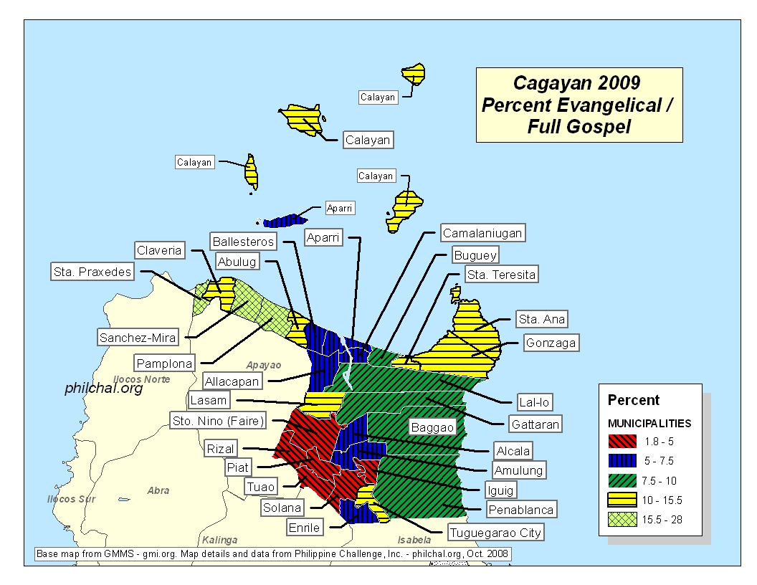

Slide 4
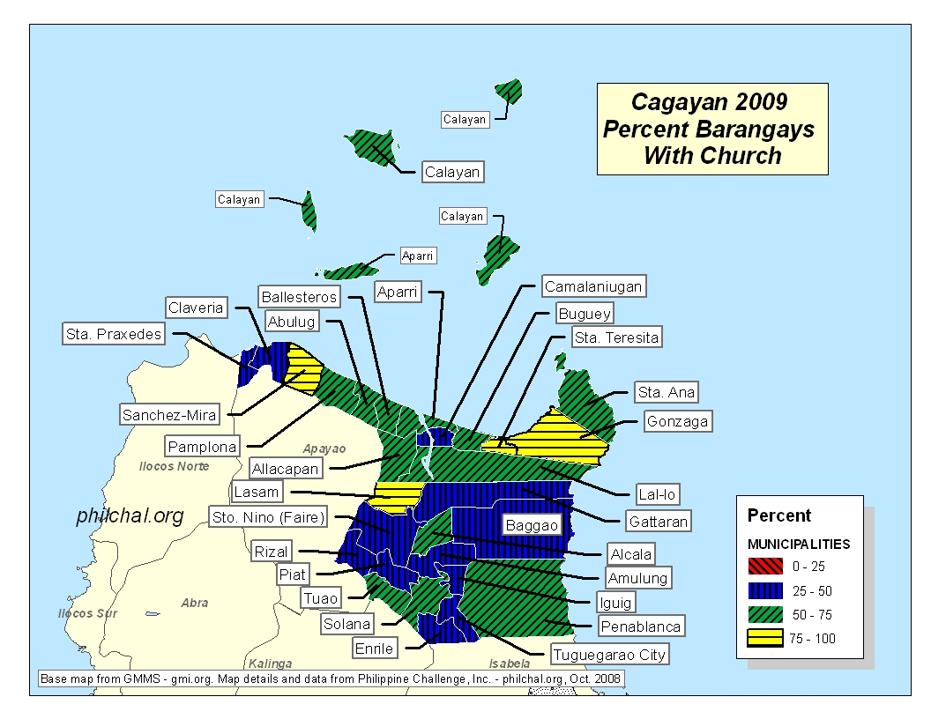

Slide 5
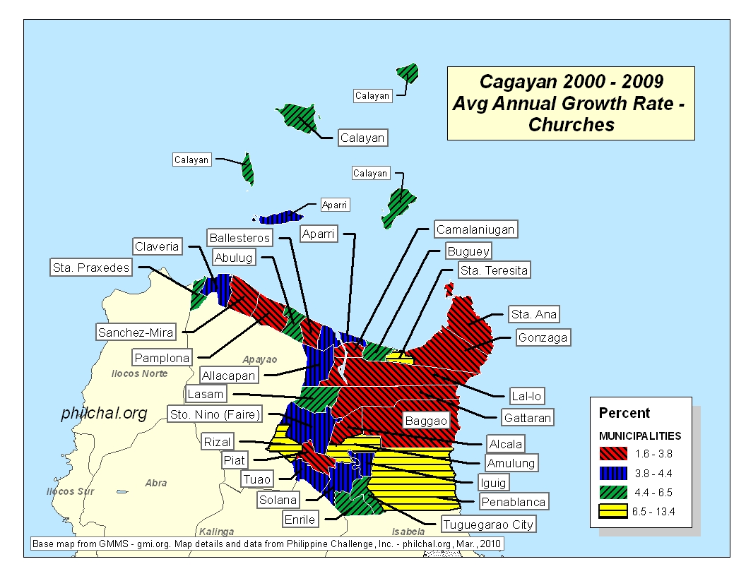

Slide 6
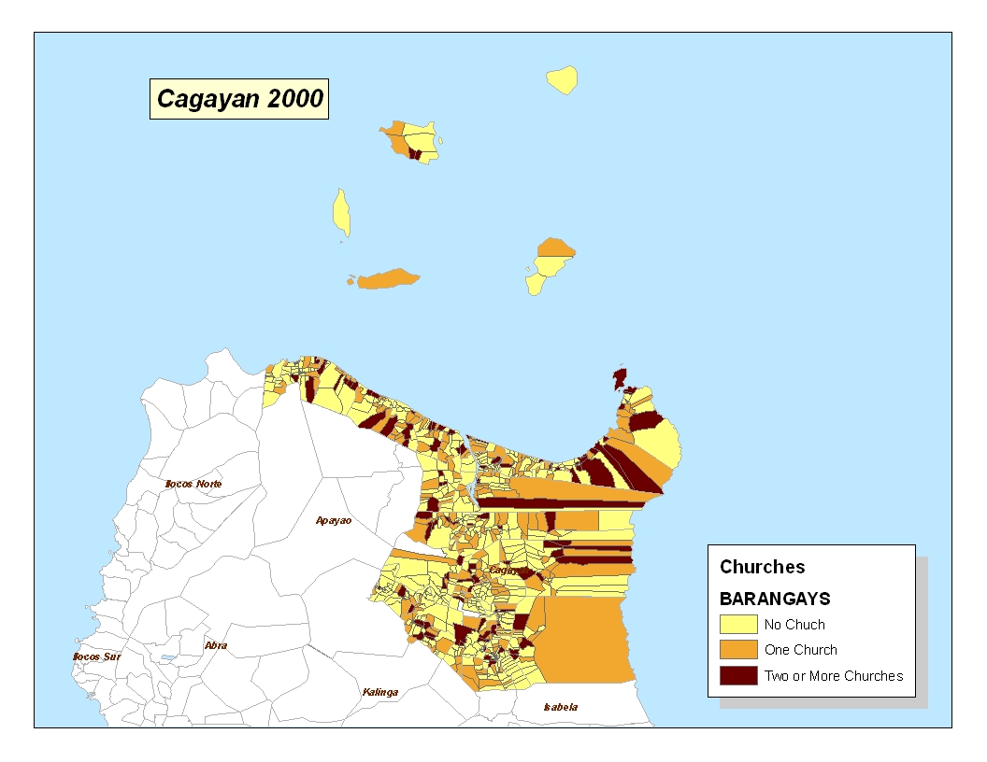

Slide 7
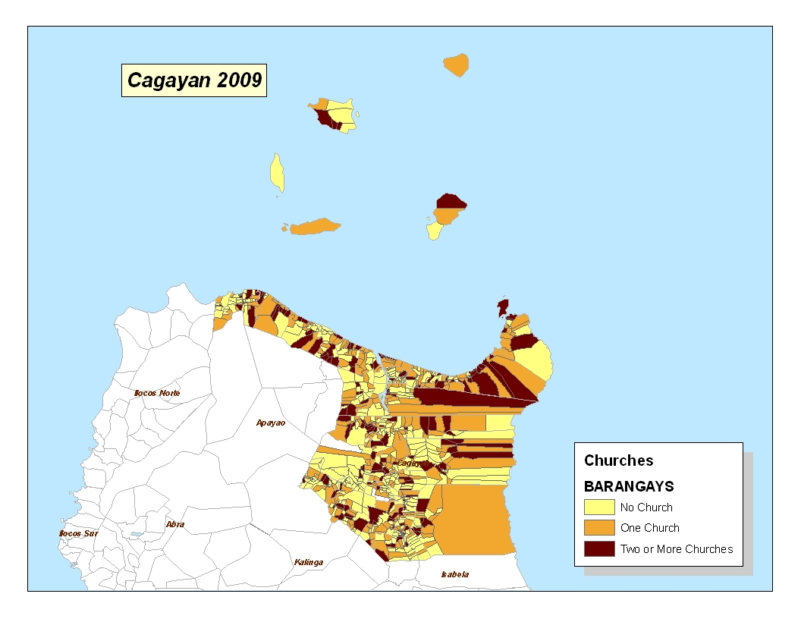

Slide 8
Greatest Percentage of Barangays with a Church
Notes:
8

Slide 9
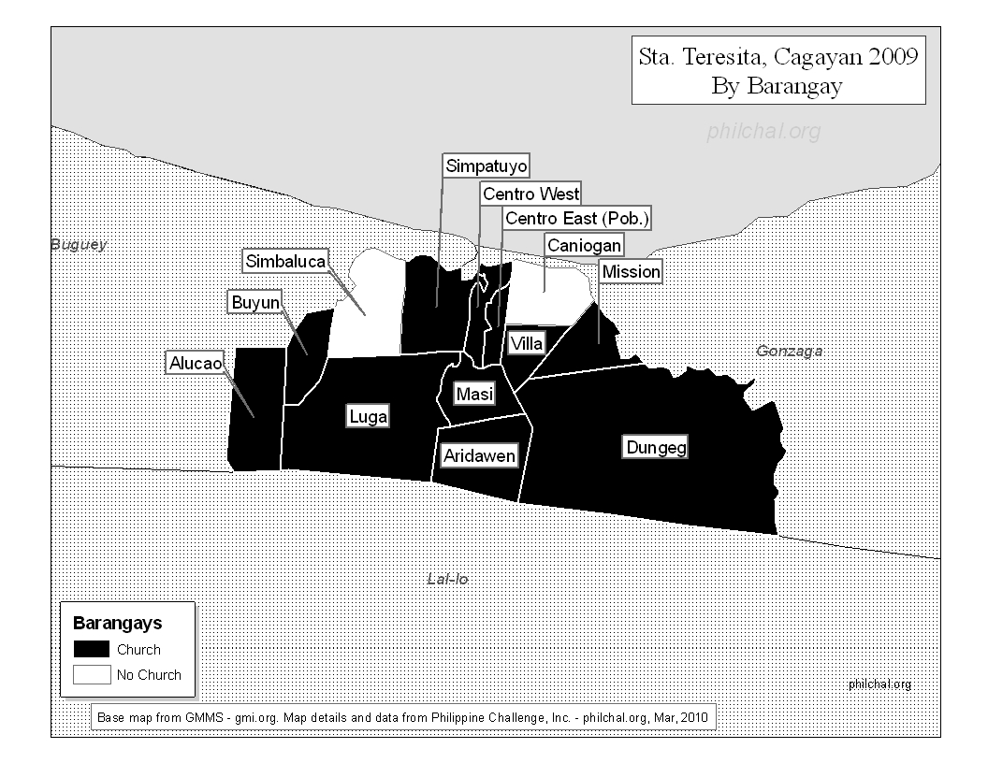

Slide 10
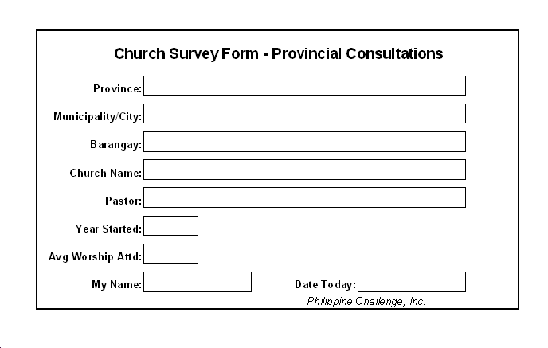
Notes:
10

Slide 11
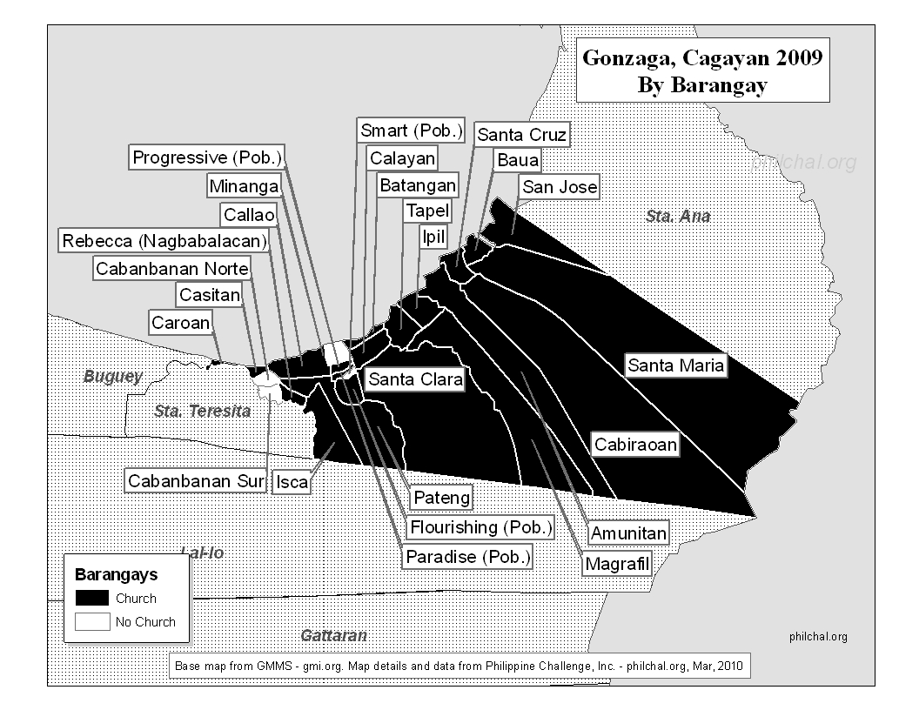

Slide 12
Least Percentage of Barangays with a Church
Notes:
12

Slide 13
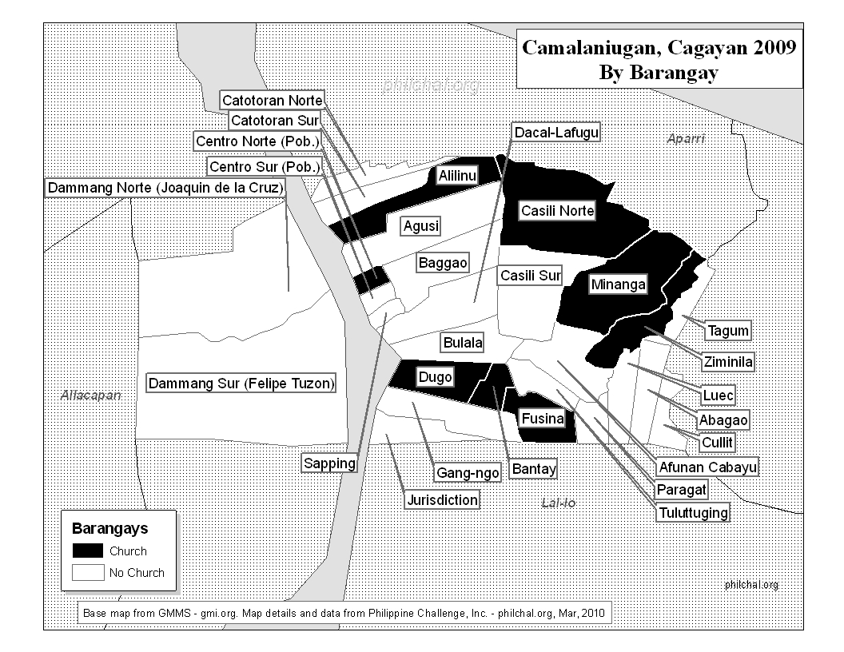

Slide 14
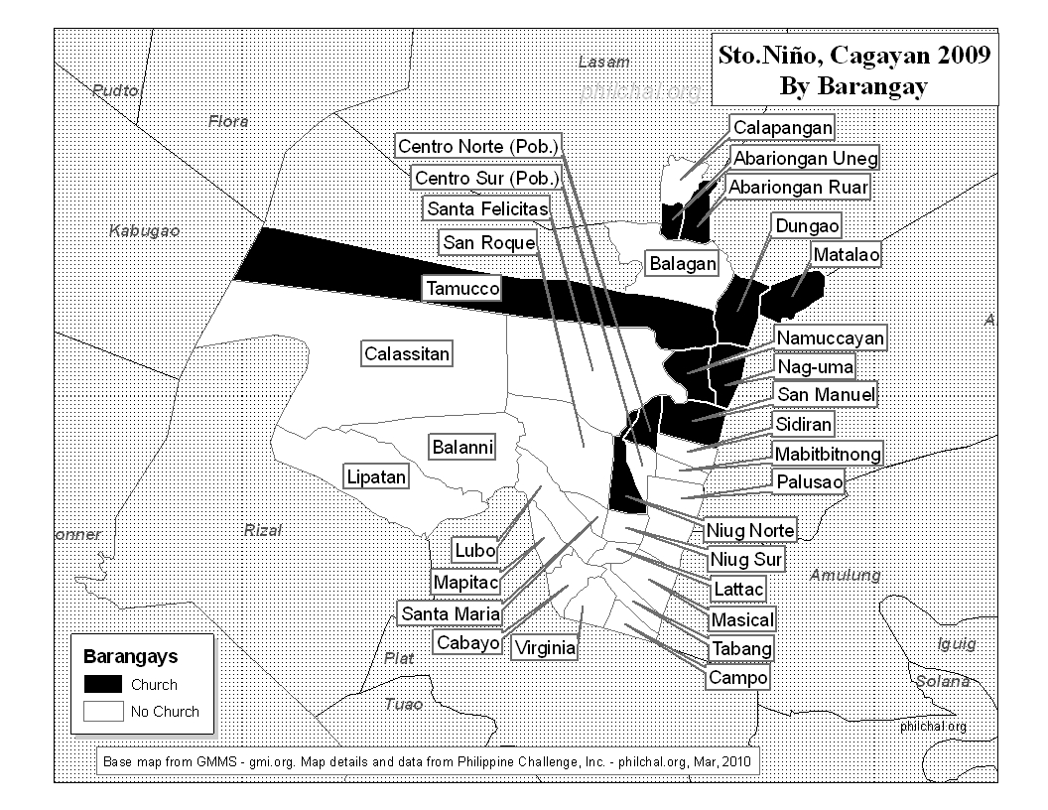

Slide 15
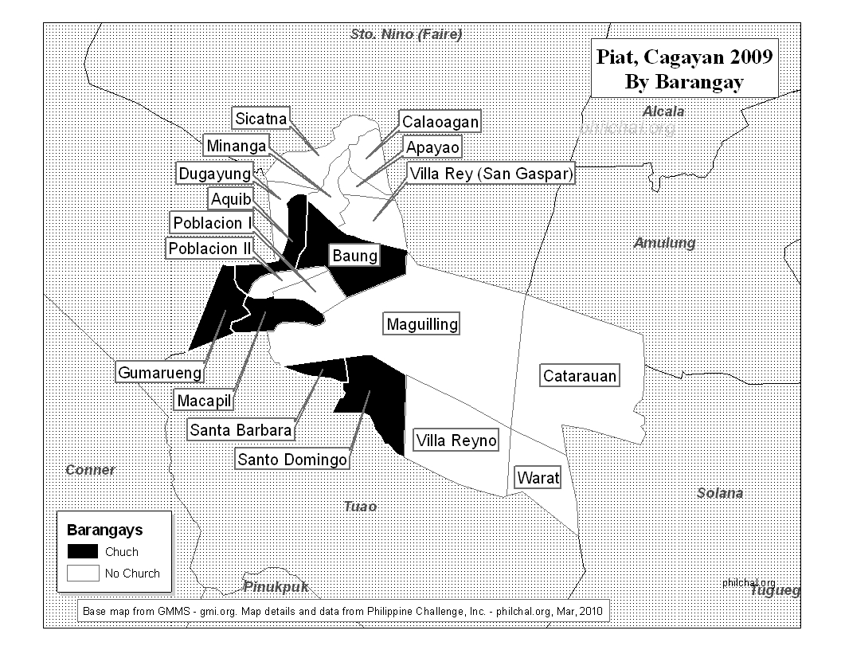

Slide 16
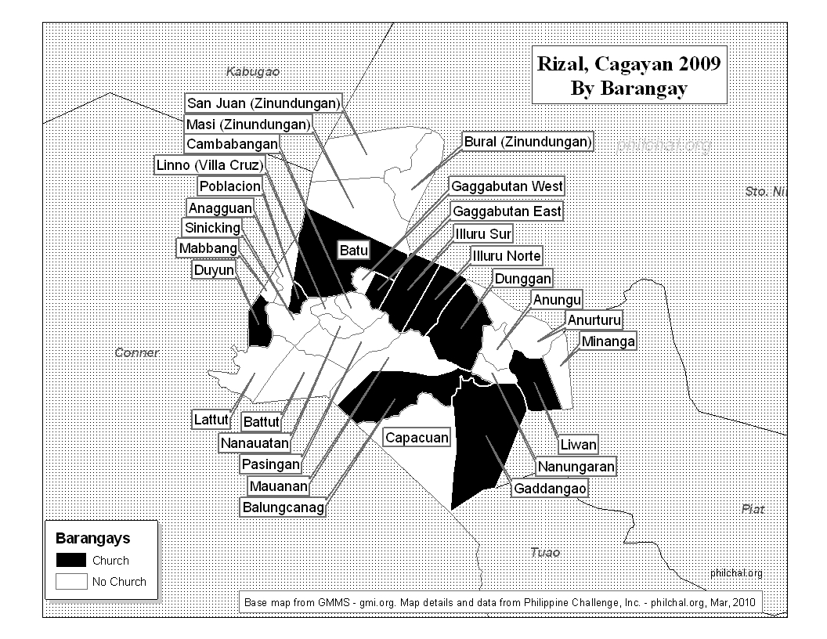

Slide 17
All Municipalities and Cities
Notes:
17

Slide 18
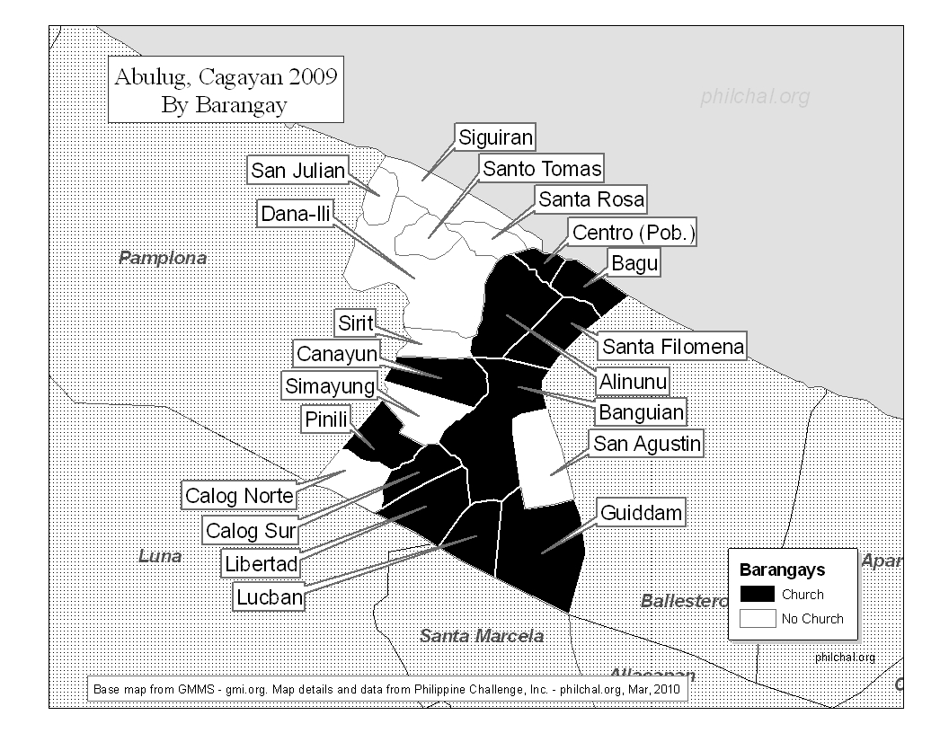

Slide 19
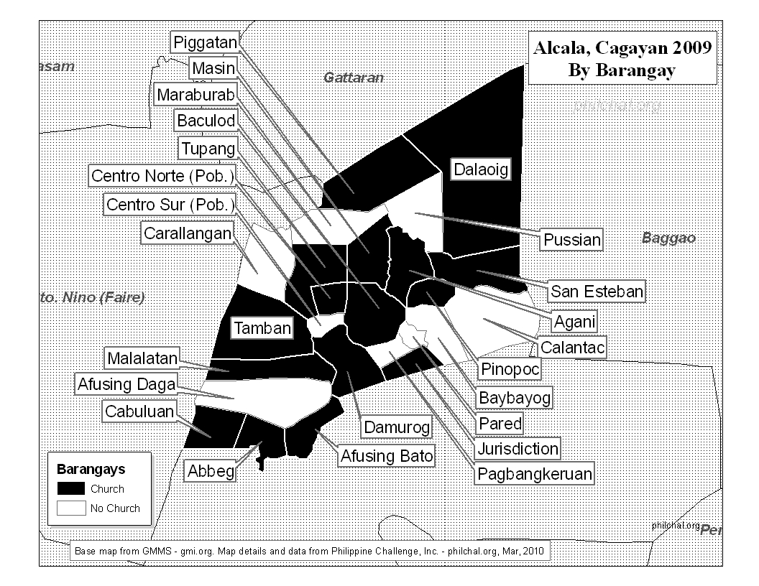

Slide 20
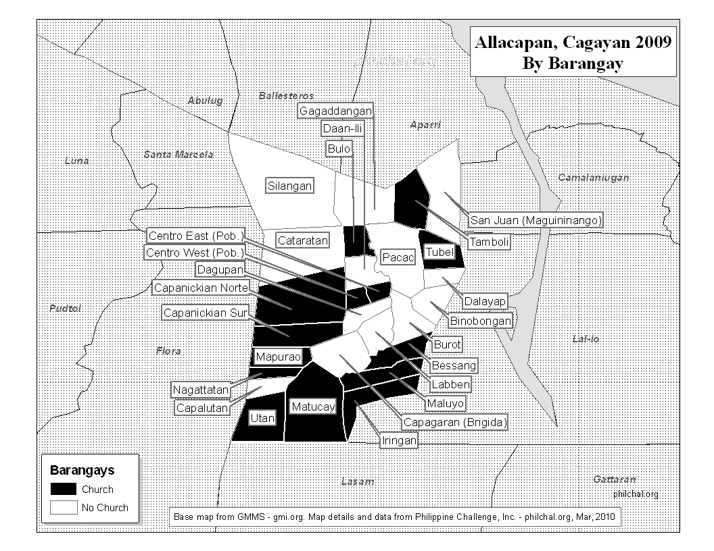

Slide 21
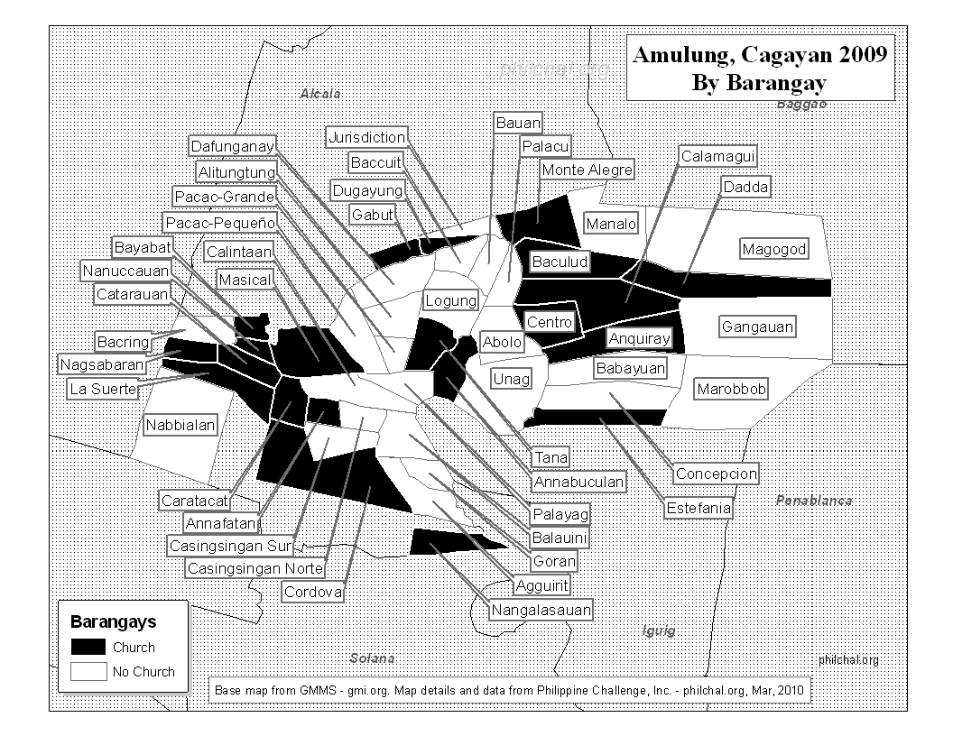

Slide 22
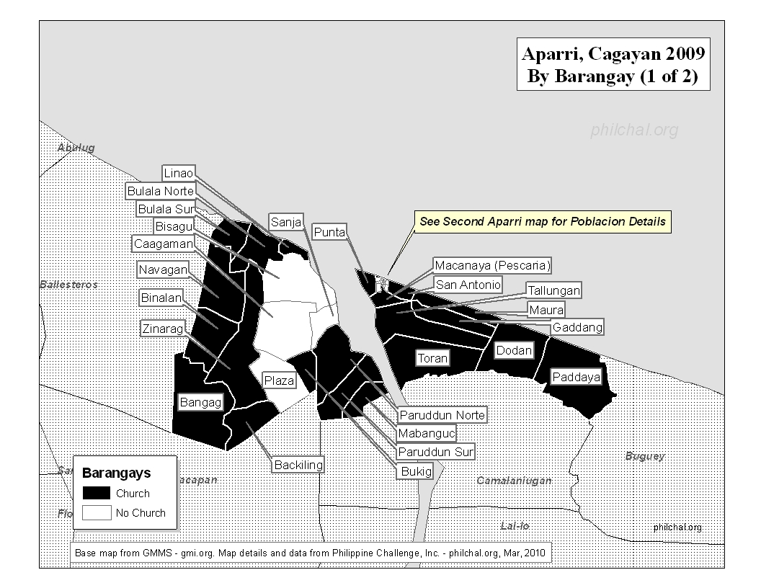

Slide 23
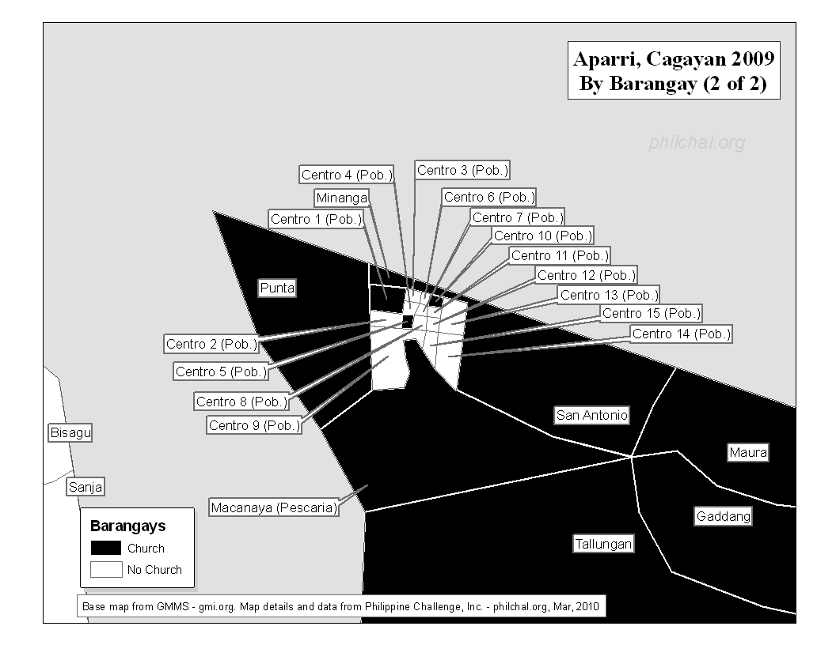

Slide 24
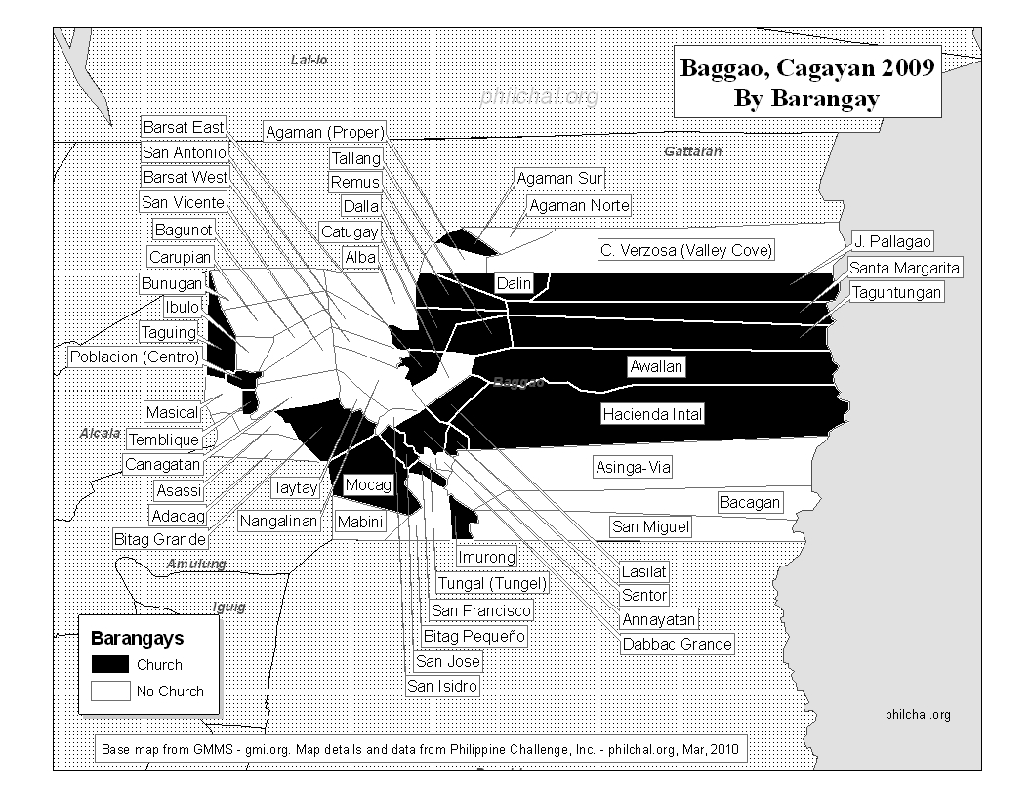

Slide 25
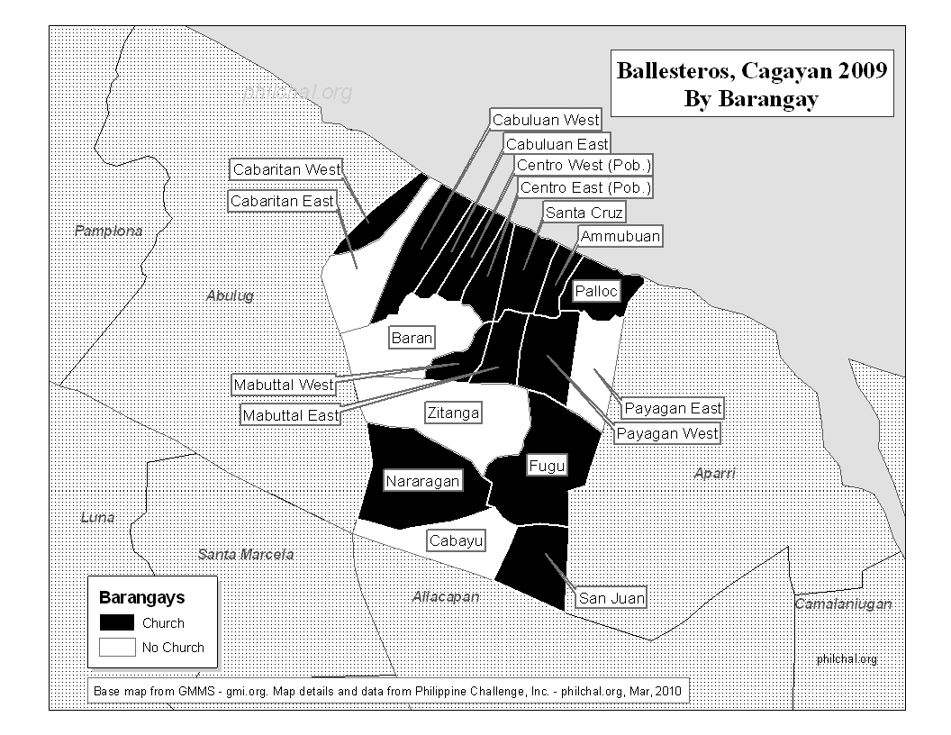

Slide 26
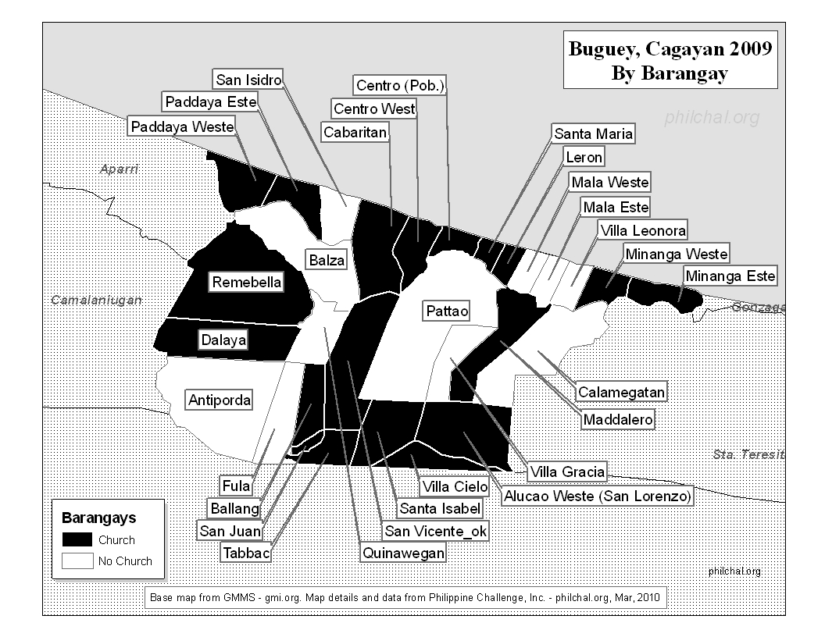

Slide 27
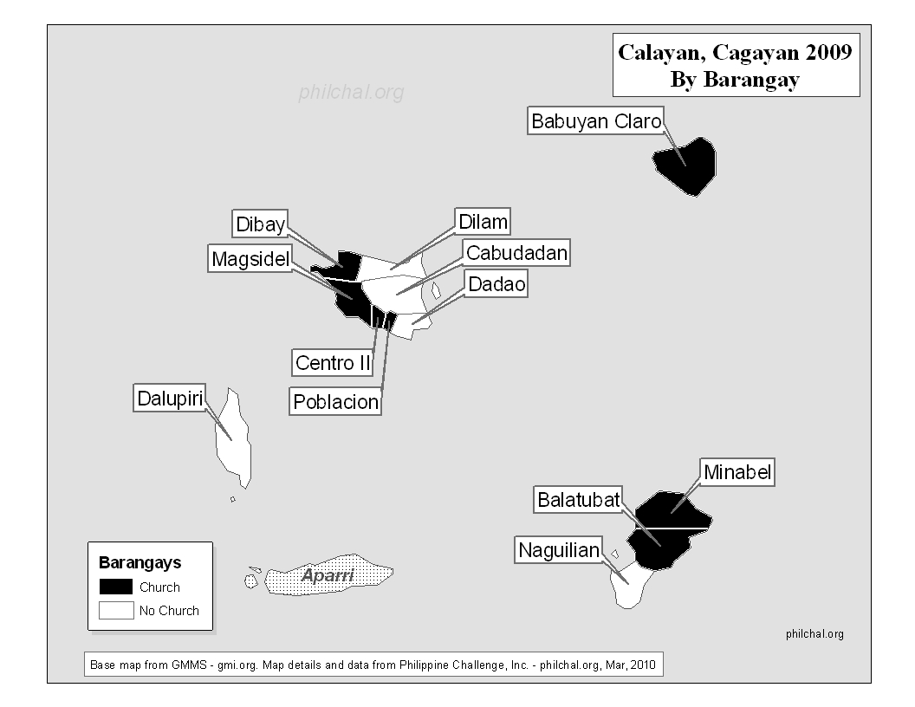

Slide 28
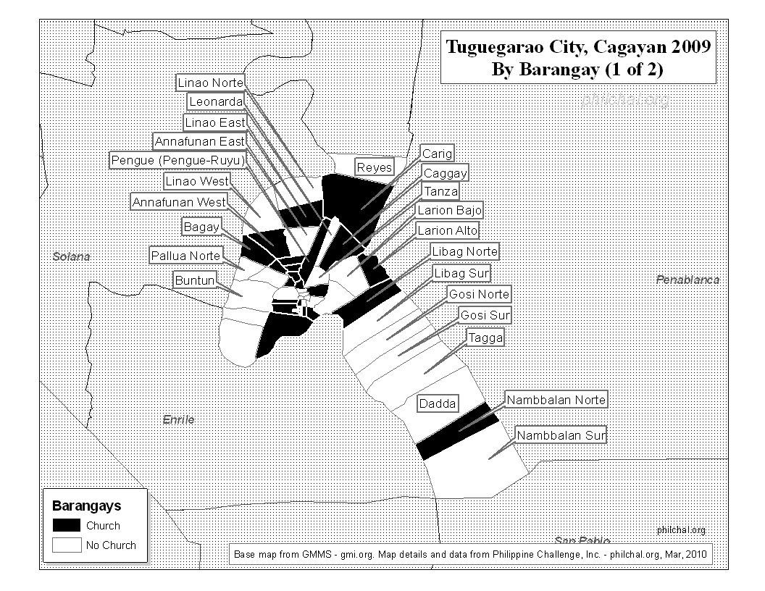

Slide 29
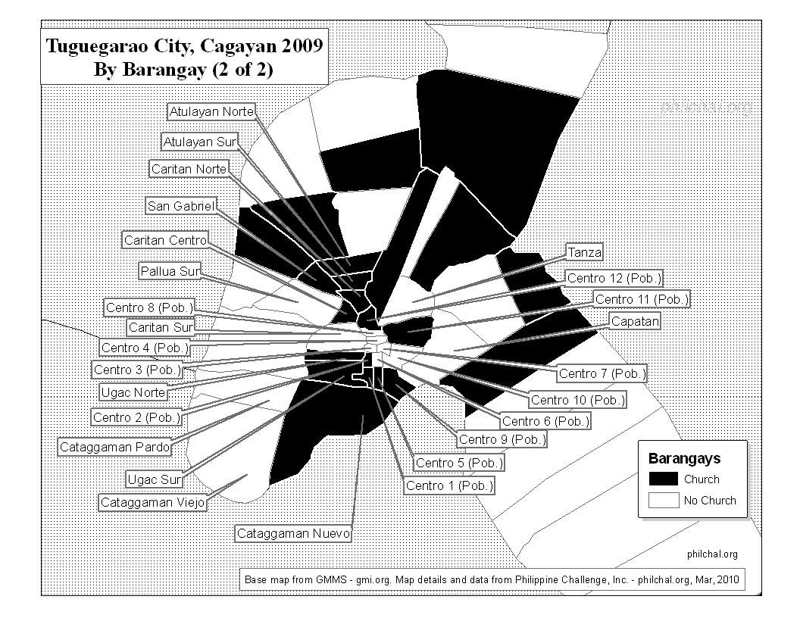

Slide 30
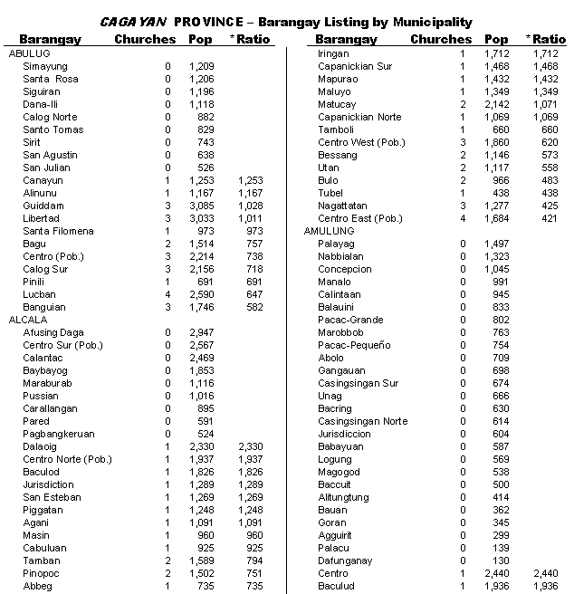

Slide 31
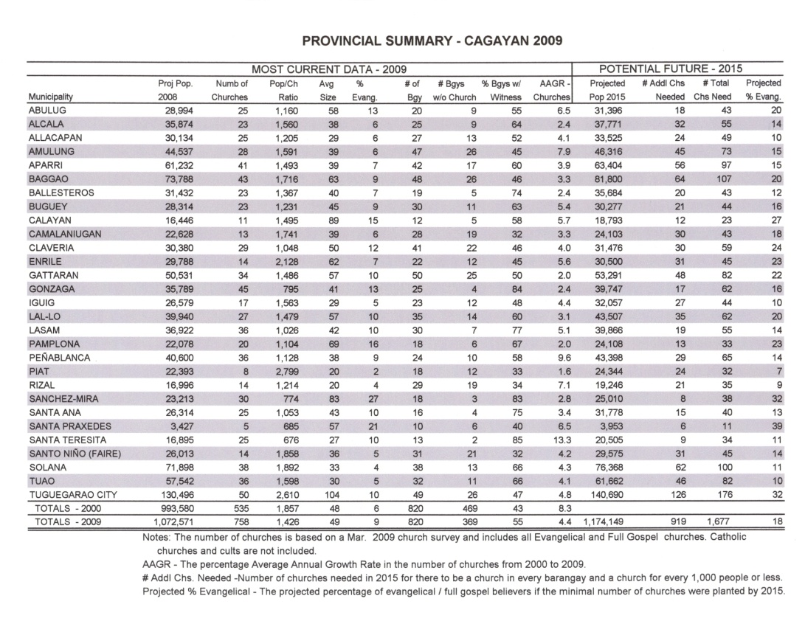

What can you learn about your town from the maps and barangay list?
Notes:
31

Slide 32
Notes:
32

Slide 33
Research
Highlights
Notes:
33

Slide 34
Percent Evangelical/Full Gospel
Cagayan
Notes:
34

Slide 35
Percentage of barangays with a church
Cagayan

Slide 36
Barangays without a church
Cagayan
Notes:
36

Slide 37
Growth rate in number of churches
Cagayan
Notes:
37

Slide 38
In Cagayan, more than __________ people live in barangays without even one church.
340,000

Slide 39

How to obtain this information
Philippine Challenge website: www.philchal.org
Purchase a CD
today
From your local leader
Notes:
39

